Slide 1

SECURITY CONTROLS
SECURITY ARCHITECT
FOO KAI YAN
33085625
Notes:
INTRODUCTIONS TITLE PAGE

Slide 2
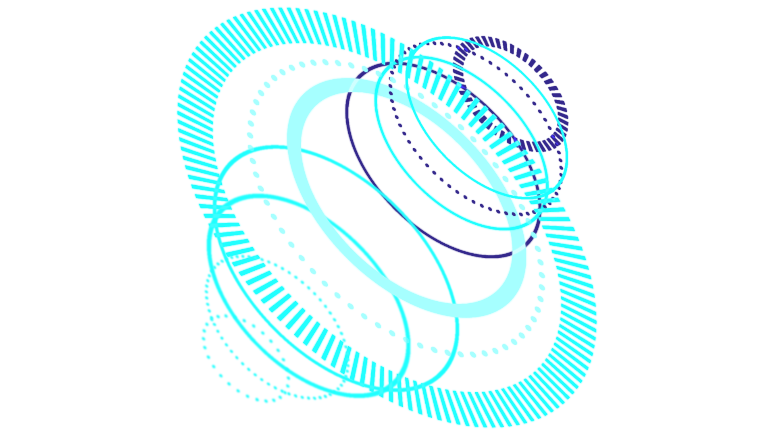
TABLE OF CONTENTS
SCHEME
01
DESCRIPTION
02
SUPPLEMENT INFORMATION
03
NETWORK DIAGRAM WITH SECURITY CONTROLS
SECURITY CONTROLS EXPLAINED
DESCRIPTION, APPENDIX
Notes:
PART OF INTRODUCTIONS

Slide 3


INTRODUCTION
ROLE : SECURITY ARCHITECT
PURPOSE : USE A LIST OF SECURITY CONTROLS TO CONNECT A NUMBER OF ENTITIES TO THE INTERNAL NETWORK WHILST ENSURING THE ORGANISATION IS PROTECTED FROM INTERNAL AND EXTERNAL ADVERSARIES
Notes:
PART OF INTRODUCTIONS

Slide 4
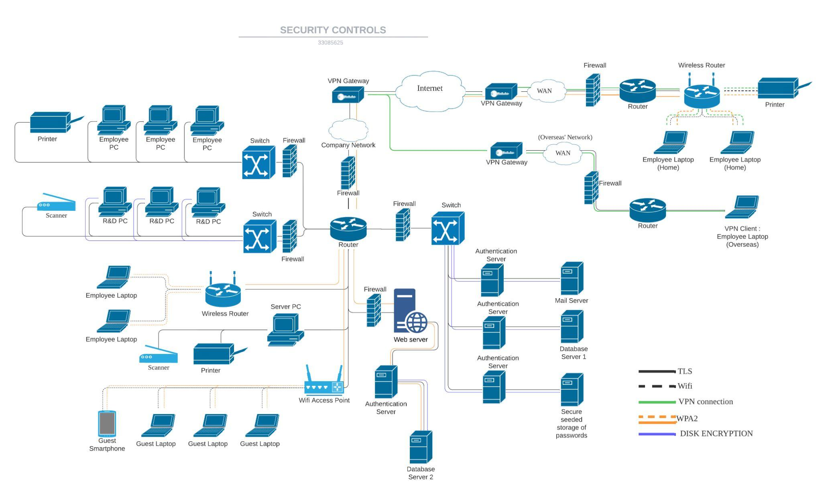
DIAGRAM
MADE WITH LUCIDCHART

Slide 5

FIREWALLS
FIRST LINE OF NETWORK SECURITY DEFENCE
MONITOR NETWORK TRAFFIC
ALLOW OR BLOCK SPECIFIC TRAFFIC
PREVENT HACKING, VIRUS ATTACK, SPYWARE
BARRIER BETWEEN PUBLIC AND PRIVATE INTERNET
NETWORK-BASED FIREWALLS
STOP UNAUTHORISED ACCESS
PREVENT UNNECESSARY NETWORK TRAFFIC
RETRIEVED FROM :
https://www.miradore.com/blog/hard-drive-encryption-full-disk-encryption/
https://www.checkpoint.com/cyber-hub/network-security/what-is-firewall/#:~:text=A%20Firewall%20is%20a%20network,network%20and%20the%20public%20Internet

Slide 6
VPN GATEWAY
VPN CLIENTS
RETRIEVED FROM :
https://cloud.google.com/vmware-engine/docs/concepts-vpn-gateways
https://www.techradar.com/vpn/remote-access-vpn
SECURE CONNECTION
SUPPORT MULTIPLE CONNECTIONS
SECURE VIRTUAL TUNNEL
PROTECTED BY ENCRYPTION & SECURITY PROTOCOLS
DATA SECURITY - S.E.C.U.R.E.
VPN CLIENT INITIATED THE CONNECTION
SOFTWARE ON CLIENT’S DEVICE
SECURELY ACCESS DATA AND RESOURCES
RETRIEVED FROM :
https://www.dummies.com/article/technology/information-technology/networking/general-networking/network-administration-vpn-servers-and-clients-184879/
Notes:
Software on client’s device that connect with remote network (company’s network)

Slide 7
TLS
TRANSPORT LAYER SECURITY
PROTECT CONFIDENTIALITY & INTEGRITY
PASSWORDS, STAFFS PERSONAL INFORMATION
RESILIENCE AGAINST UNAUTHORISED TAMPERING OF DATA
ENCRYPT COMMUNICATION SENT
ASYMMETRIC & SYMMETRIC ENCRYPTION
PROTECT CONFIDENTIALITY & INTEGRITY OF DATA-IN-TRANSIT
ASYMMETRIC = ESTABLISH SECURE SESSION
SYMMETRIC = EXCHANGE DATA WITHIN SECURE SESSION
RETRIEVED FROM :
https://www.techtarget.com/searchsecurity/definition/Transport-Layer-Security-TLS
https://www.cloudflare.com/learning/ssl/transport-layer-security-tls/
Notes:
Asymmetric = establish secure session between client and server

Slide 8

SECURE SEEDED STORAGE OF PASSWORDS
AUTHENTICATION SERVER
RETRIEVED FROM :
https://www.okta.com/uk/identity-101/authentication-server/
STORAGE SPACE FOR ALL RELEVANT ACCOUNT PASSWORDS
ENCRYPTED & DECRYPTED = AES-256
SAFE AGAINST BRUTE FORCE ATTACKS
MANAGE PROCESSES
IDENTIFY IMPOSTERS
PROTECT CRITICAL ASSETS
VERIFY EMPLOYEES’ RIGHTS TO ACCESS FILES & DATA
USERNAME/PASSWORD COMBINATION METHODS:
SINGLE-FACTOR
MULTIFACTOR
RETRIEVED FROM :
https://www.techtarget.com/searchsecurity/definition/Advanced-Encryption-Standard
Notes:
Single-factor: When the user enters the correct data in both fields, authentication is complete. In this case, the password is the one factor the server verifies.
Multi-factor: The correct username/password combination isn't enough. The site requires one more step to complete authentication. That may involve sending a temporary passcode to a linked device, using a Yubikey, or other methods.

Slide 9

DISK ENCRYPTION
CONVERT DATA TO UNREADABLE CODE
DATA THAT GOES IN DISK
HARDWARE / DISK ENCRYPTION SOFTWARE
PROTECT A DISK
ENCODING DATA, SYSTEM FILES
TYPES
FULL DISK ENCRYPTION
FILE-LEVEL ENCRYPTION
RETRIEVED FROM : https://www.miradore.com/blog/hard-drive-encryption-full-disk-encryption/
Notes:
APPENDIX

Slide 10

RETRIEVED FROM :
https://www.avast.com/c-wep-vs-wpa-or-wpa2
https://www.pandasecurity.com/en/mediacenter/security/wpa-vs-wpa2/
WPA2 ENCRYPTION
ENSURE DATA SENT & RECEIVED IS ENCRYPTED
SECURED
ENTITIES WITH PASSWORD CAN ONLY ACCESS IT
POOR AUTHENTICATION IMPLEMENTED
POOR CHOOSING OF PASSWORDS
LONG PASSWORD TO CREATE SECURE NETWORK
Notes:
APPENDIX

Slide 11
APPENDIX
MASTER PASSWORD
DATA-IN-TRANSIT
THE ONLY IMPORTANT PASSWORD AS IT CAN HELP ACCESS & RECOVER ALL ACCOUNTS’ PASSWORDS NO MATTER WHAT DEVICE IS USED
DATA ACTIVELY MOVING FROM ONE LOCATION TO ANOTHER (Eg. CLIENT ↔ SERVER)
CRITICAL ASSETS
SPYWARE
COMPANY’S ESSENTIAL RESOURCES TO MAINTAIN OPERATIONS AND ACHIEVE COMPANY’S MISSION (Eg. FINANCIAL DATA, PATENTS, COPYRIGHTS)
MALWARE INSTALLED ON TECHNOLOGICAL DEVICES WITHOUT USERS’ KNOWLEDGE
Notes:
APPENDIX

Slide 12
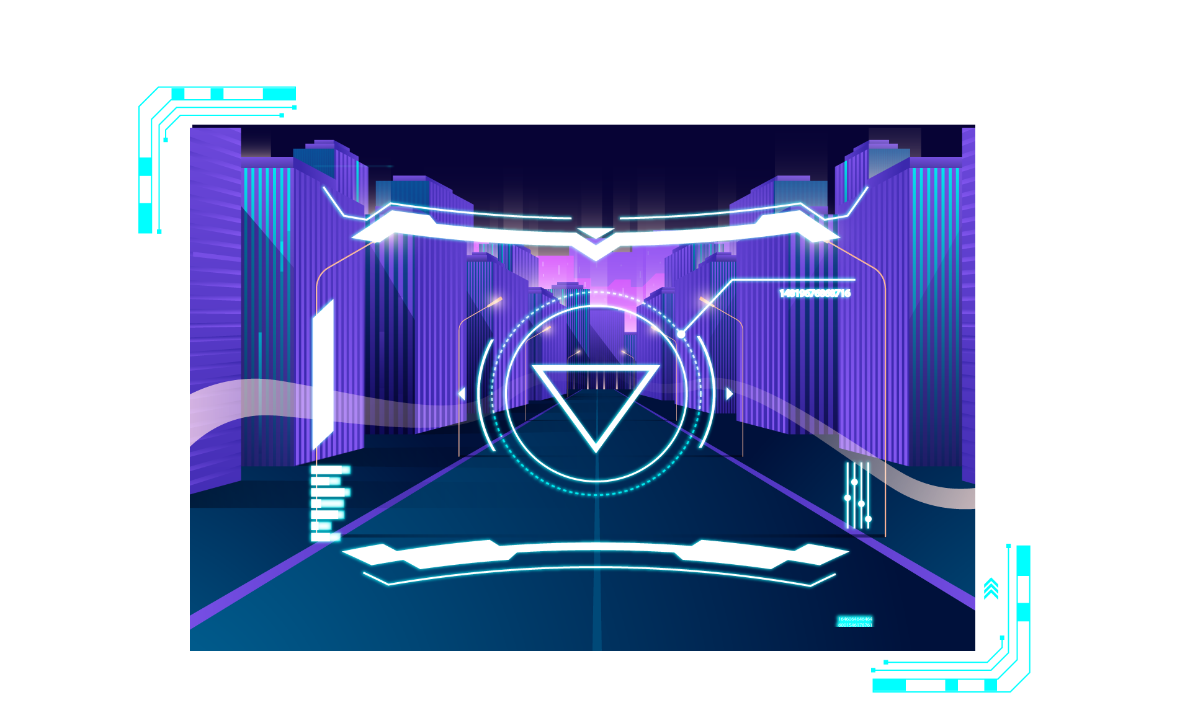
THANK YOU
Notes:
THANK YOU PAGE

Slide 13
THE NETWORK DIAGRAM (BIGGER PICTURE) ON THE NEXT SLIDE
Notes:
BLANK

Slide 14


